Slide 1
Lecture 9
Dr. Lauren Chenarides
October 21, 2025

Slide 2
We develop our character muscles by overcoming challenges and obstacles. -Steven Covey (Author “The 7 Habits of Highly Effective People”)

Slide 3

Lecture 9: Legal & Market Challenges in Agribusiness and Food Ventures
Textbook Reading (Quiz Basis)
Chapter 9. Legal Challenges for Entrepreneurial Ventures
Chapter 10. Marketing Challenges for Entrepreneurial Ventures
Lecture Agenda
1. Legal Challenges in Agribusiness
2. Marketing Challenges in Agribusiness

Slide 4
Chapter 9 Objectives
Explain the importance of legal issues for entrepreneurs.
Identify patent protection, including definitions and preparation.
Discuss copyrights and their relevance to entrepreneurs.
Explain trademarks and their impact on new ventures.
Identify the legal forms of organization—sole proprietorship, partnership, and corporation.
List the advantages and disadvantages of each of these three legal forms.
Explain the nature of the limited partnership and limited liability partnerships.
Discuss how an S corporation works.
Define the additional classifications of corporations, including limited liability companies (LLCs), B corporations, and low-profit, limited liability companies (L3Cs).
Identify the major segments of the bankruptcy law that apply to entrepreneurs.

Slide 5
Chapter 10 Objectives
Explain the new marketing concept for entrepreneurs.
Discuss the importance of marketing research for new ventures.
Identify the key elements of an effective market survey.
List the factors that inhibit the use of marketing.
Explain the emerging use of social media marketing and mobile marketing for entrepreneurial firms.
Identify the components of effective marketing.
Summarize the marketing concept: philosophy, segmentation, and consumer orientation.
Identify the areas vital to a marketing plan.
List the key features of a pricing strategy.
Discuss pricing in the social media age.

Slide 6
Lecture Content
By the end of this lecture, students should be able to:
Identify core legal challenges agribusiness and food entrepreneurs face, including regulatory compliance, food safety and liability, contracts, cottage food laws, and succession planning.
Explain how federal agencies (USDA, EPA, FDA) regulate food and agricultural ventures and how those regulations affect different stages of business development—from startup to growth.
Apply food safety standards (GAP and GMP) to real-world scenarios involving traceability and product recalls.
Evaluate how contracts provide certainty in volatile agricultural markets through pricing mechanisms, quality specifications, and force-majeure clauses.
Compare legal frameworks such as commercial vs. cottage food production and understand when each applies.
Describe key marketing hurdles faced by agribusiness ventures—limited skills/resources, high competition, poor market access, quality perception, and high costs.
Analyze strategies to overcome marketing barriers, such as cooperative marketing, value-added differentiation, and direct-to-consumer channels.
Assess how rising input and labor costs influence marketing and pricing strategies in small food businesses.
Connect real-world cases (e.g., Haribo) to entrepreneurial decisions around focus, adaptation, and economies of scale.

Slide 7
Overview
Legal challenges for agribusiness entrepreneurs include navigating complex environmental, food safety, and labor regulations.
Marketing challenges stem from high competition, lack of marketing skills, poor access to markets, and issues like product quality, storage, and high transportation costs.
Takeaway: Entrepreneurs must balance production costs with marketing needs, often a significant challenge due to rising input prices and labor costs, in a highly regulated environment.

Slide 8
Icebreaker Activity: Haribo Case Study
"Why Haribo Refuses to Expand Beyond Gummies"
As you watch the video, answer the following questions to connect a global candy giant's strategy to the challenges faced by small food entrepreneurs:
How does having different coloring agents in its international product portfolio (e.g., using natural dyes in other countries) help Haribo prepare for potential future US regulations, like a ban on Red 40?
The video mentions Haribo is essentially a "one-product company." How does this strategy help them achieve "economies of scale" (lowering costs)? How can a startup food venture apply this idea of focus?
Haribo modifies its products for different regions (e.g., more red bears in the US, different Star Mix contents). How does localizing production (the Wisconsin factory) and adapting the product mix solve their market access challenge and boost sales?

Slide 9
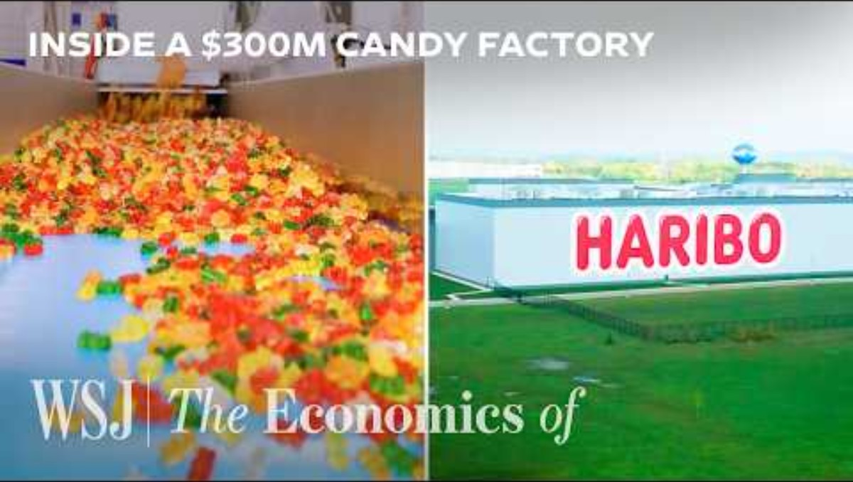

Slide 10
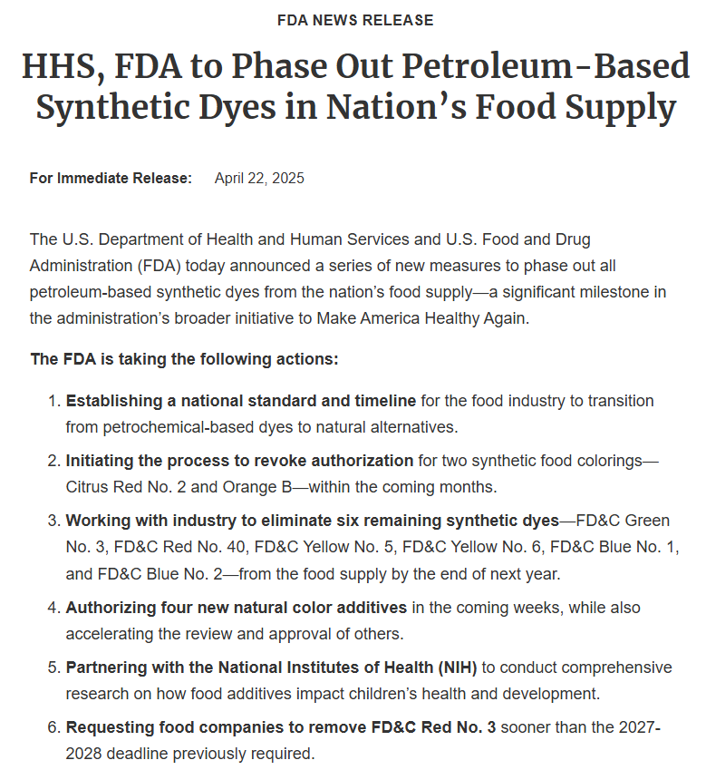
Question 1: Legal - Regulatory Compliance
International Portfolio Action | Benefit for US Regulatory Preparation
Using Natural Dyes in Other Markets | De-risks future compliance. Already having scaled, tested, compliant alternatives (natural fruit/veg coloring) ready to deploy if US regulations change (e.g., banning Red 40).

Slide 11
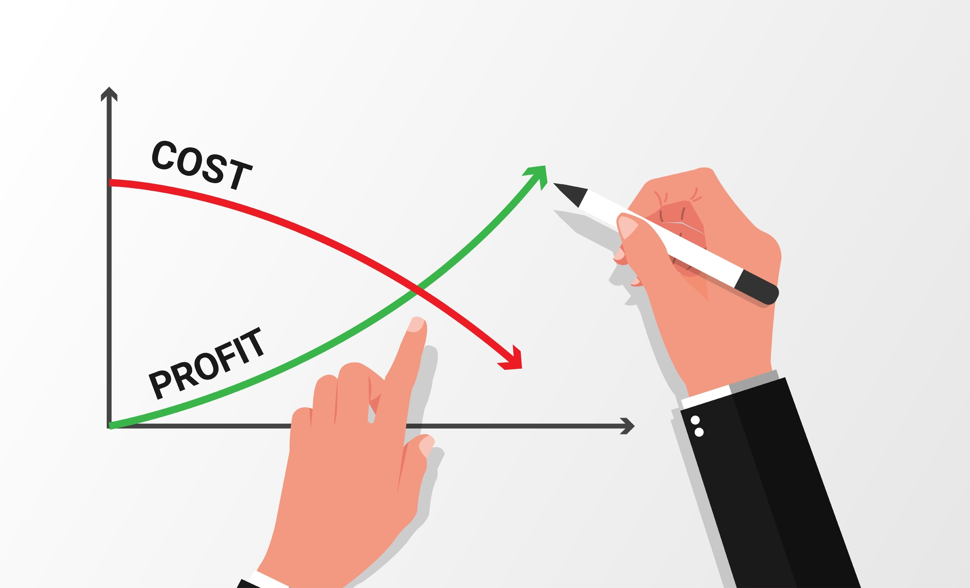
Question 2: Marketing - Strategy and Costs (Focus)
Haribo's Strategy | Implication for Costs | Small Business Application
"One-Product Company" (Gummies) | Bulk purchasing of fewer ingredients achieves economies of scale (lower unit cost). | Ruthless Focus. Perfect 1-2 recipes to maximize input efficiency (buying volume) and minimize production waste.

Slide 12
Question 3: Marketing - Market Access and Adaptation
Haribo's Action | Challenge Solved | Sales Mechanism
Localizing Production (US Factory) | Solves Market Access by cutting delivery time from months to weeks, reducing spoilage risk. | Faster delivery and replenishment leads to better retailer relationships and fewer missed sales.
Adapting the Product Mix | Solves Competition by tuning flavor/texture to local preference (e.g., US wants more raspberry). | Direct adaptation increases purchase likelihood and brand loyalty over generic products.

Slide 13
Part 1: Legal Challenges

Slide 14
Focusing the Lens: Farm to Fork
The journey from farm to fork is regulated at every step.
As entrepreneurs, your legal duties extend far beyond simple business registration—they encompass:
Soil & Water: Environmental laws and land use permits.
Product Handling: Food safety standards (GAP, GMP, Cottage Food).
Distribution: Contract certainty and liability for transport.

Slide 15



Federal Regulations in Agribusiness
Let’s consider that food and agriculture is one of the most heavily regulated industries in the world.
US Department of Agriculture (USDA)
Oversees animal-based agriculture
Sets meat price limits and inspects quality
Regulates food safety for perishables
Establishes dietary regulations
Environmental Protection Agency (EPA)
Guides use of agricultural chemicals and pesticides
Enforces Clean Water Act, Clean Air Act, and Federal Insecticide, Fungicide and Rodenticide Act
Food and Drug Administration (FDA)
Regulates most food products (except meat and some animal products)
Oversees growing, harvesting, processing, packaging, storing, and transporting of food
Has authority to mandate food recalls

Slide 16
Each Venture Phase is Affected in Different Ways
Inception of the Venture:
Choosing the right legal structure (LLC, S-Corp, Partnership)
Permitting for specific operations (e.g., wastewater, on-farm sales, commercial kitchen use).
Ongoing Venture:
Regulatory Compliance (Pesticide use, zoning, water rights).
Contract Certainty (Dealing with volatile commodity prices).
Labor Laws (Seasonal and migrant workforce regulations).
Growth and Continuity:
Intellectual Property (Brand trademarks, unique seed varieties).
Succession Planning (Estate planning for the farm/business).

Slide 17
Core Legal Challenges
Regulatory Compliance
Food Safety and Liability
Contract Law & Supply Chains
Cottage Food Laws
Estate and Business Planning

Slide 18
Core Legal Challenges
Regulatory Compliance
Food Safety and Liability
Contract Law & Supply Chains
Cottage Food Laws
Estate and Business Planning

Slide 19
Adherence to the Laws
Food & ag ventures must adhere to a wide range of federal, state, and local laws, including:
Environmental Protection:
Nutrient management (fertilizer/manure runoff) and water use rights.
Land Use/Zoning:
Ensuring your property is zoned for the intended activity (e.g., production, on-farm retail, processing).
Labor Laws:
Managing wage/hour compliance for seasonal workers and compliance with programs like H-2A.

Slide 20
Why It’s Complex and Costly
The rules often vary dramatically by jurisdiction.
For example, a new poultry operation must navigate USDA inspection rules, EPA (water discharge) permits, and local zoning (noise and odor control) rules, turning a single project into a multi-agency compliance effort.
In Colorado, the employees of the State Board of Stock Inspection are charged with protecting the Colorado livestock industry.

Slide 21
Core Legal Challenges
Regulatory Compliance
Food Safety and Liability
Contract Law & Supply Chains
Cottage Food Laws
Estate and Business Planning

Slide 22
Protecting Consumers and the Business
Entrepreneurs must establish robust procedures to ensure product safety and avoid devastating liability.
Key Standards
Good Agricultural Practices (GAP): Focuses on farm-level food safety (water quality, worker hygiene, soil amendments).
Good Manufacturing Practices (GMP): Focuses on processing and packing facilities (sanitation, equipment maintenance, pest control).
Generally, these are voluntary, but their effective implementation is often a de facto requirement to participate in the commercial food supply chain.
Notes:
Direct Legal Requirement (Generally No): Most food safety regulations (like the FDA's FSMA, or Food Safety Modernization Act) mandate compliance with specific outcomes, not specific voluntary programs like GAP or GMP.
Market Requirement (Absolutely Yes):
Buyers Mandate Them: Large retailers (like Walmart, Kroger) and major food processors (like Nestle) require their suppliers to be certified in GAP or GMP (or a similar Global Food Safety Initiative, GFSI, scheme). If you are not certified, you cannot access high-value markets.
Traceability and Liability: Implementing GAP/GMP is the best way to prove you have exercised due diligence and reduced risk. In the event of a foodborne illness outbreak, an entrepreneur who follows these documented procedures is in a much better legal position than one who does not.
In short, while the government might not throw you in jail for not having a GAP certificate, the market will shut you out. For any entrepreneur wanting to scale beyond a farmers market, they are essential.

Slide 23
Traceability and Recall
You must have a "one-step-forward, one-step-back" system.
If a product is contaminated, how quickly can you:
Identify exactly where it went (forward)?
Identify exactly where the problematic inputs came from (back)?

Slide 24
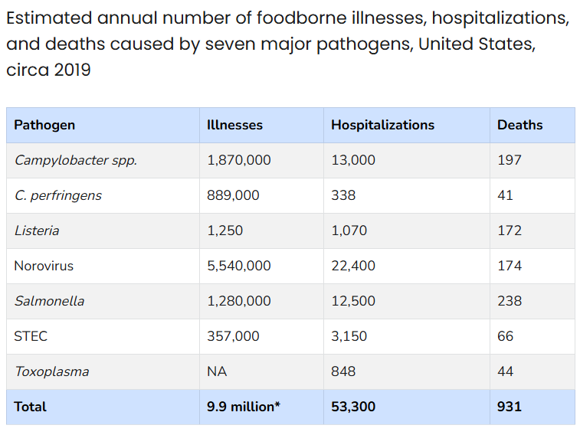
Liability Exposures
Contaminated Products:
Illnesses linked to your food (e.g., E. coli in spinach).
Escaped Substances:
Non-food liabilities, like pesticide drift damaging a neighbor's organic crop, or nutrient runoff polluting a local stream.
Source (CDC)

Slide 25
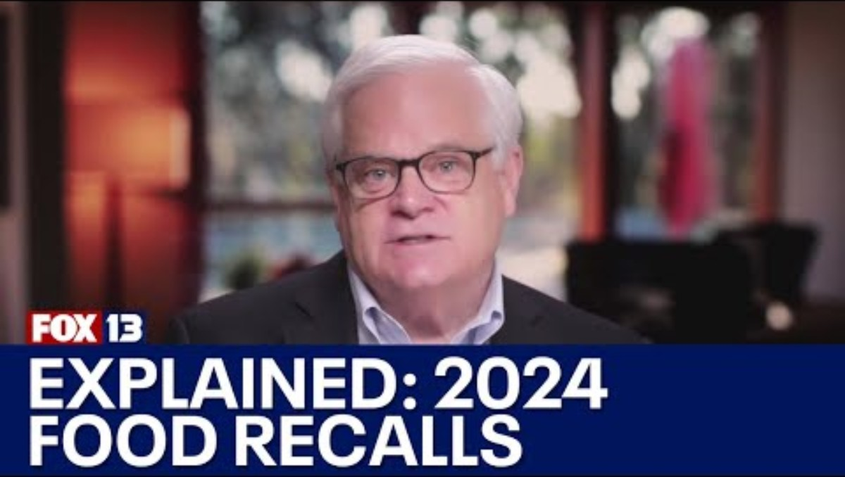

Slide 26
Activity: The Lumpy Lemonade Incident
A small juice bar starts pressing and bottling its own fresh, raw juice on-site.
The local health department shuts them down temporarily after a customer reports illness.
Which standard (GAP or GMP) is primarily relevant to their pressing and bottling operation?
What is the first piece of information the juice bar needs to collect to start their "one-step-back" traceability effort?
Notes:
1. Which standard (GAP or GMP) is primarily relevant to their pressing and bottling operation?
The standard primarily relevant to the pressing and bottling operation is Good Manufacturing Practices (GMP).
Reasoning: GAP (Good Agricultural Practices) covers the growing, harvesting, and field-packing of the raw inputs (e.g., the fruit/vegetables grown on the farm). GMP covers the subsequent processing, handling, bottling, and storage of food in a dedicated manufacturing facility (the juice bar's kitchen, in this case).
2. What is the first piece of information the juice bar needs to collect to start their "one-step-back" traceability effort?
The first piece of information they need to collect is the source of the raw produce (fruit/vegetables) used in the juice batch that made the customer ill.
Reasoning: "One-step-back" traceability requires knowing where their ingredient came from. The juice bar must immediately identify the specific supplier, farm, and lot code of the raw ingredients (e.g., the carrots, apples, or spinach) that went into the implicated juice batch. This allows them to trace the potential contamination source back to the initial agricultural supplier.

Slide 27
Core Legal Challenges
Regulatory Compliance
Food Safety and Liability
Contract Law & Supply Chains
Cottage Food Laws
Estate and Business Planning

Slide 28
Navigating Contracts for Certainty
In agribusiness, certainty is needed for planning.
Contracts manage risk and secure inputs/outlets in a volatile environment.
Help to stabilize volatile prices: Contracts must lock in supply or price to hedge against commodity market swings.
Help to maintain specific quality: Growers contract with processors (e.g., for tomatoes or grapes) to ensure they meet very specific criteria like Brix level (sugar content) or moisture level, which impact the final processed product.

Slide 29
What’s Included in a Contract?
Pricing Mechanisms: Using futures, fixed-price, or floor/ceiling agreements.
Force Majeure: Clauses addressing weather-related failures, transportation disruptions, and other 'Acts of God' common in agriculture.
Example: A farmer contracts with a high-end restaurant group to supply microgreens year-round. This contract requires guaranteed weekly volume and specifies the exact variety, packaging, and delivery time—all necessary for the restaurant to maintain menu consistency.

Slide 30
Core Legal Challenges
Regulatory Compliance
Food Safety and Liability
Contract Law & Supply Chains
Cottage Food Laws
Estate and Business Planning

Slide 31

Home-Based Production and Limitations
Cottage Food Laws allow small entrepreneurs to prepare certain non-potentially hazardous foods in their home kitchens without requiring a commercial-grade facility.
This dramatically lowers the startup cost barrier.

Slide 32
Key Restrictions (Varies by State)
Permitted Foods | Prohibited | Sales Venue | Revenue Cap | Labeling
Generally limited to non-perishables like baked goods (no cream fillings), jams, jellies, and dried herbs. | Meat, raw dough, highly perishable items. | Often restricted to direct-to-consumer sales (farmers markets, on-farm, online with local pickup) and prohibited from wholesale or interstate commerce. | States impose an annual maximum gross revenue (e.g., $25,000 to $50,000). | MANDATORY specific labeling stating the product was prepared in a non-inspected home kitchen.
Notes:
States with Cottage Food Laws (as of 2024):
49 states have some form of Cottage Food Law
New Jersey was the last state to adopt these laws in 2022
Variations between states:
Allowed products (e.g., baked goods, jams, dried herbs)
Sales limits
Licensing and inspection requirements
Colorado's Cottage Food Act:
Allows sales up to $10,000 per product annually
Requires food safety training
Specific labeling requirements

Slide 33
Difference between Cottage Food and GMP
If you want to sell your homemade granola at a local craft fair, Cottage Food is your entry point.
If you want to sell it in every major grocery store in the state, you need a commercial kitchen and GMP compliance.

Slide 34
Core Legal Challenges
Regulatory Compliance
Food Safety and Liability
Contract Law & Supply Chains
Cottage Food Laws
Estate and Business Planning

Slide 35
Planning for Succession and Financial Security
Planning for the future, including succession and potential bankruptcy, is an important but often overlooked, especially in family-owned farms and food businesses where personal and business assets are intertwined.

Slide 36
Succession Planning
Agribusiness often involves valuable, illiquid assets (land, equipment).
Succession planning ensures the business can transition smoothly to the next generation or a new owner without being broken up due to inheritance taxes or family disputes.

Slide 37
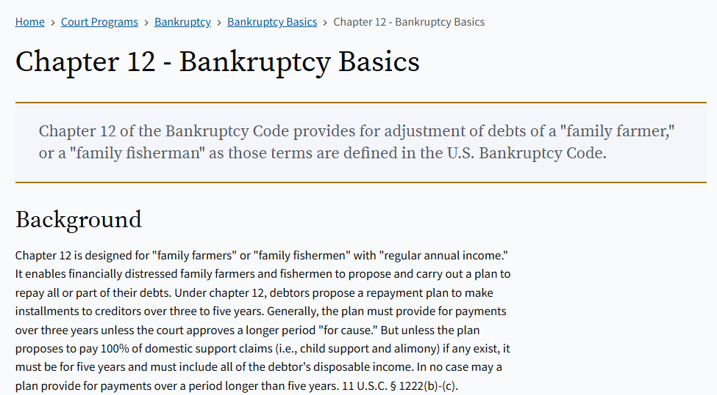
Bankruptcy (Chapter 12)
While all businesses can file for standard reorganization (Chapter 11) or liquidation (Chapter 7), farmers have a unique provision: Chapter 12.
This is designed specifically for "family farmers" or "family fishermen" to reorganize their debts while keeping the operation running—an important tool given the volatility of farm income.

Slide 38
Part 2: Marketing Challenges

Slide 39
The Market Landscape
In the food and beverage industry, you are competing not just with similar products (another brand of yogurt) but also with consumer choices across categories (a restaurant meal vs. cooking at home).
Marketing in agribusiness is about turning a commodity product (e.g., a chicken) into a differentiated, branded value proposition (e.g., a "Certified Humane, Pasture-Raised Chicken from Sunnyside Farm").

Slide 40
Key Marketing Hurdles
Lack of skills and resources.
High competition (Local vs. Global).
Difficult market access.
Product quality and perception.
High costs (Marketing, Storage, Transportation).

Slide 41
Key Marketing Hurdles
Lack of skills and resources.
High competition (Local vs. Global).
Difficult market access.
Product quality and perception.
High costs (Marketing, Storage, Transportation).

Slide 42
Lack of Skills and Resources
Many small food and farm entrepreneurs are experts in production (growing, cooking) but lack the necessary skills and capital to develop and execute effective marketing plans (e.g., digital advertising, brand design, retail buyer pitches).
Solutions:
Cooperative Marketing Hubs: Producers pool capital to hire a shared expert (the "Co-op Agency") for branding, digital advertising, and high-quality photography, spreading the cost and gaining specialized skills.
Leverage Aggregators/Distributors: Partner with existing local food distributors who specialize in sales and logistics, immediately gaining access to high-value retail buyers and professional pitch execution.
Focus on Business Incubation: Use incubators that offer free or subsidized training in financial forecasting, brand narrative development, and retail pitching.

Slide 43
Key Marketing Hurdles
Lack of skills and resources.
High competition (Local vs. Global).
Difficult market access.
Product quality and perception.
High costs (Marketing, Storage, Transportation).

Slide 44
High Competition
The market is saturated, making it difficult to stand out and secure a profitable customer base.
Against Large-Scale Operations: A national beverage company can out-spend and out-price your local sparkling water due to massive economies of scale.
Against Other Options: Consumers have infinite choices. Your artisanal cheese competes with every other quick-snack option available.

Slide 45
Activity: Facing High Competition
The Haribo video demonstrated how they use focus (on gummies) and adaptation (local flavor/mix) to compete with diversified giants like Hershey's.
Now, think about a successful, small food or beverage brand you love (e.g., a craft coffee roaster, a small-batch jerky company, or a boutique hot sauce).
Question: How does this small brand compete against the major players (like Starbucks or Frito-Lay)?
Specifically, what is their "Haribo" move? Do they focus on a unique ingredient, a specific value (sustainability), or a particular regional market that the large players ignore?
(Hint: They rarely compete on price—they compete on story, quality, and values.)

Slide 46
Key Marketing Hurdles
Lack of skills and resources.
High competition (Local vs. Global).
Difficult market access.
Product quality and perception.
High costs (Marketing, Storage, Transportation).

Slide 47
The Logistics of Getting to the Shelf
Entrepreneurs can face difficulties accessing high-value markets, which are often concentrated in urban or distant areas.
Barriers:
Poor Infrastructure: Bad local roads or a lack of reliable, accessible cold storage can cause spoilage before the product reaches the buyer.
Distance from Markets: Transportation and time-to-market increase costs and risk, making it harder to serve distant, high-value markets.

Slide 48
The Logistics of Getting to the Shelf
Entrepreneurs can face difficulties accessing high-value markets, which are often concentrated in urban or distant areas.
Barriers:
Lack of Effective Sales Channels: Getting your product into a major retail chain requires navigating complex systems of brokers, distributors, and slotting fees—processes designed for high volume that exclude small players.
Strategy: These challenges often force small operators toward Direct-to-Consumer (D2C) channels (farmers' markets, CSA, online stores) to maximize margins and bypass traditional distribution gatekeepers.

Slide 49
Solutions to Market Access Challenges
Challenge Barrier | Solution Strategy | Benefit
Poor Infrastructure / Cold Chain Risk | Use Food Hubs/Aggregators: Centralized, shared cold storage and consolidated large-volume transport. | Mitigates spoilage; shifts logistics burden away from the small producer.
Distance from Markets / High Transport Costs | Invest in D2C E-commerce: Ship directly to customers with specialized, optimized packaging and regional carriers. | Bypasses traditional middle layers, accessing distant consumers while maximizing margins.
Lack of Effective Sales Channels (Retail) | Hire a Food Broker or Join a Sales Co-op: Pay commission to a specialized entity that already has retail buyer relationships. | Gains professional access to large retail chains without needing in-house expertise or large volume guarantees.
High Spoilage Risk (Fresh Produce) | Shift to Value-Added Products: Process perishables into shelf-stable goods (jams, frozen, canned). | Extends shelf life and tolerance for imperfect transport conditions.

Slide 50
Key Marketing Hurdles
Lack of skills and resources.
High competition (Local vs. Global).
Difficult market access.
Product quality and perception.
High costs (Marketing, Storage, Transportation).

Slide 51
Promoting Unique Attributes
Low product quality will always hinder marketing efforts.
However, high-quality products also fail if their unique attributes are not clearly and convincingly promoted.
The Perception Hurdle
Consumers rely heavily on visual cues (price, packaging, brand name) to judge quality.
A small-batch product must work harder to convey its value than a known national brand.

Slide 52
Value-Added Characteristics
Entrepreneurs need to clearly articulate the value of their product, which often revolves around:
Source: "Pasture-raised," "Single-origin," "Heritage grain.“
Process: "Hand-harvested," "Small-batch," "Naturally fermented.“
Values: "Certified Organic," "B-Corp," "Locally sourced.“
Example: Simply selling "eggs" is commodity marketing.
Selling "Large Brown Eggs from Hens Raised on a Regenerative Farm" is differentiated marketing that justifies a premium price.

Slide 53
The Economics of Organic Standards
What Organic Means (The Legal Barrier)
Definition: A legal, audited marketing claim (not just a production practice) enforced by the USDA.
Requirement: Land must be free of prohibited substances for 3 years before harvest—a costly, zero-premium transition period.
The Economics
Organic commands a significant price premium (often 30–100+%).
The premium is necessary to offset higher labor costs (manual weeding) and lower yields compared to conventional farming.

Slide 54
The Farmer Reality: Risk vs. Reward
Factor | Consumer View | Entrepreneur Reality
Price | Willingness to Pay (WTP) for values. | Must cover high transition costs (3 years of no premium).
Risk | Low health risk. | High production risk (no chemical safety net), plus annual audit fees.
As seen with the White Oaks Farm case study, the Organic label is often required for market entry, regardless of the farmer's practices.
The cost of certification is the “gate fee” to high-value markets.
The "Organic" label is a validated seal of trust that grants the price premium needed to financially sustain high-integrity, complex farming practices.

Slide 55
Key Marketing Hurdles
Lack of skills and resources.
High competition (Local vs. Global).
Difficult market access.
Product quality and perception.
High costs (Marketing, Storage, Transportation).

Slide 56
Thin Margins and Rising Inputs
Marketing, storage, and transportation costs can be substantial, impacting profitability, especially when combined with rising input and labor costs.
Costs Driving Thin Margins:
Storage (Cold Chain): For highly perishable food, reliable refrigerated transport and cold storage are non-negotiable and extremely expensive capital expenditures.
Transportation: Fuel and logistics are high and volatile costs that disproportionately affect smaller businesses without volume discounts.

Slide 57
Thin Margins and Rising Inputs
Marketing, storage, and transportation costs can be substantial, impacting profitability, especially when combined with rising input and labor costs.
Costs Driving Thin Margins:
Rising Input/Labor Costs: Increases in seed, fertilizer, and equipment maintenance, combined with minimum wage or seasonal labor costs, squeeze margins before the product even hits the market.

Slide 58
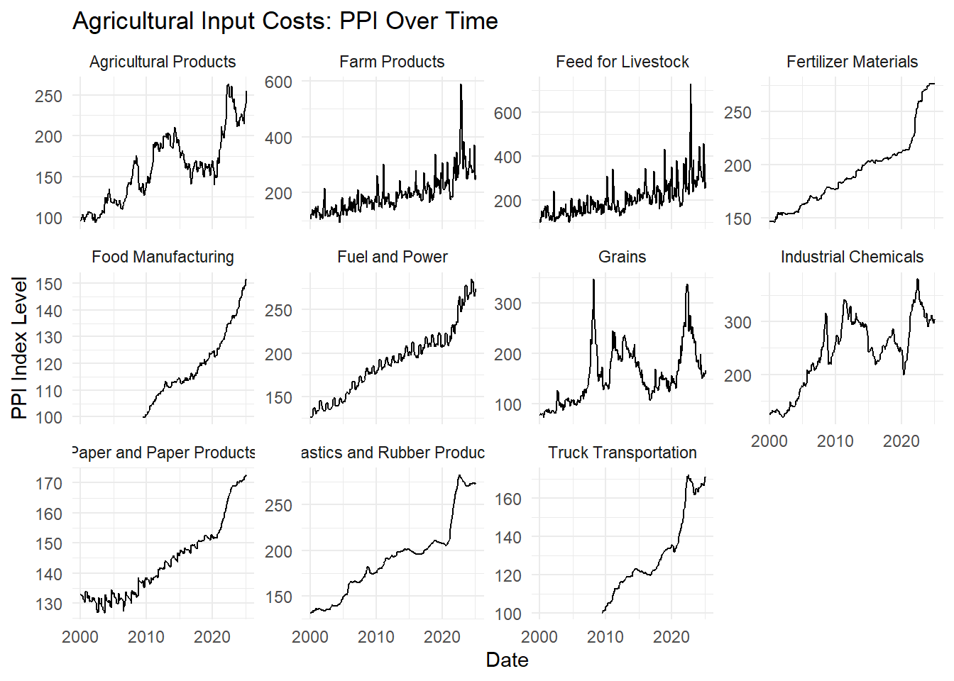
Agricultural input costs have changed over time using the Producer Price Index (PPI) from the U.S. Bureau of Labor Statistics. These input prices affect producers and may influence price transmission to retail food categories.

Slide 59
Activity: Increasing Sales
A local bread bakery owner says her costs are rising, but she is afraid to raise her price from $5.00 to $6.00 for a loaf.
Question: If she can't raise the price, what is one non-price-related marketing strategy she could use to increase her net profit?
(Hint: Think Volume or Value-Add).
Notes:
This is a classic dilemma for small food businesses. When a business is afraid to raise price (fear of losing customers), the only way to increase profit is to either cut costs (which is often difficult) or increase the non-price value or volume.
Here is one non-price-related marketing strategy she could use:
Solution: Increase Volume Through Subscription or Bundling
The most effective non-price strategy is to lock in predictable volume from existing customers, thereby lowering marketing costs and ensuring a consistent sales base.
Strategy: Implement a Subscription or Loyalty Program (The "Bread Club").
Mechanism (Volume): Offer a "Bread Club" membership where customers pre-pay monthly for a discounted volume package. For example, customers pay $20 at the beginning of the month for five $5 loaves, instead of buying four individually.
Customer Value-Add: The customer receives a perceived discount ($1 per loaf) and the convenience of not having to purchase weekly. They might also receive a small perk like a "baker's surprise" sample or early access to new seasonal flavors.
Net Profit Impact:
The bakery guarantees $20 in recurring revenue (increased volume) without raising the $5 price visible to the public.
The pre-payment provides the bakery with working capital immediately to cover rising costs.
It reduces customer acquisition costs because the bakery spends less time and money attracting the same recurring buyer.

Slide 60
Protecting and Promoting Your Venture
Challenge Category | Action Item
Legal/Regulatory | Identify all required permits (e.g., GAP/GMP, Cottage Food, Zoning) before capital investment.
Liability | Implement a traceability system that can track every batch of product one step forward and one step back.
Market Access | Prioritize Direct-to-Consumer (D2C) channels early on to bypass wholesale gatekeepers.
Competition | Focus your marketing efforts entirely on your unique attributes (story, source, process), not on price.

Slide 61
Summary
Identify core legal challenges agribusiness and food entrepreneurs face, including regulatory compliance, food safety and liability, contracts, cottage food laws, and succession planning.
Explain how federal agencies (USDA, EPA, FDA) regulate food and agricultural ventures and how those regulations affect different stages of business development—from startup to growth.
Apply food safety standards (GAP and GMP) to real-world scenarios involving traceability and product recalls.
Evaluate how contracts provide certainty in volatile agricultural markets through pricing mechanisms, quality specifications, and force-majeure clauses.
Compare legal frameworks such as commercial vs. cottage food production and understand when each applies.
Describe key marketing hurdles faced by agribusiness ventures—limited skills/resources, high competition, poor market access, quality perception, and high costs.
Analyze strategies to overcome marketing barriers, such as cooperative marketing, value-added differentiation, and direct-to-consumer channels.
Assess how rising input and labor costs influence marketing and pricing strategies in small food businesses.
Connect real-world cases (e.g., Haribo) to entrepreneurial decisions around focus, adaptation, and economies of scale.

